Slide 1

ML /DATA SCIENCE INTERN ASSIGNMENT
PRESENTED BY-NILKANTHA

Slide 2

WHO ARE YOUR LOYAL CUSTOMERS?

Slide 3
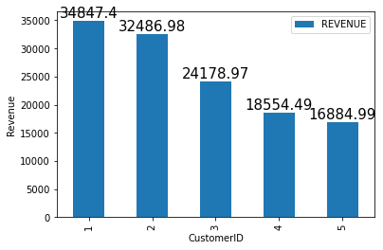
Top 5 customers

Slide 4
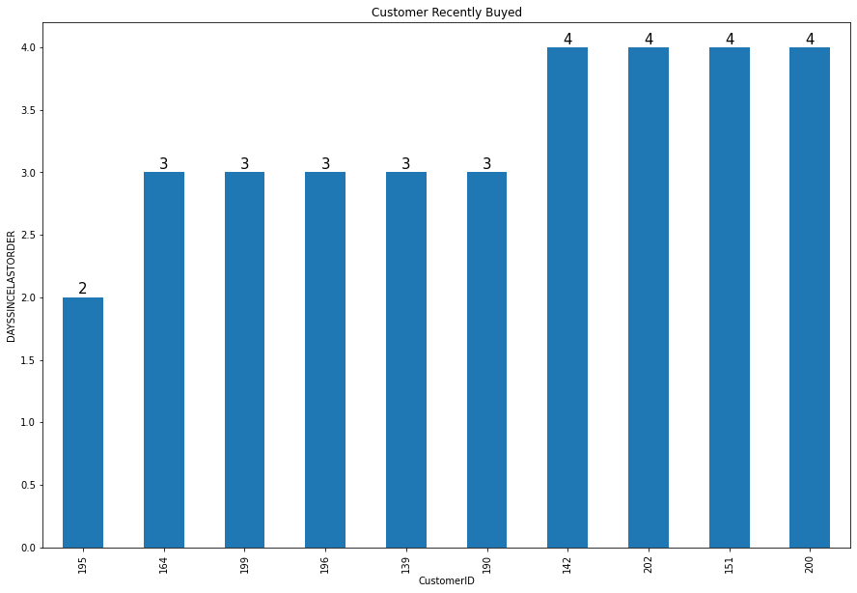
Customer who Recently buyed

Slide 5
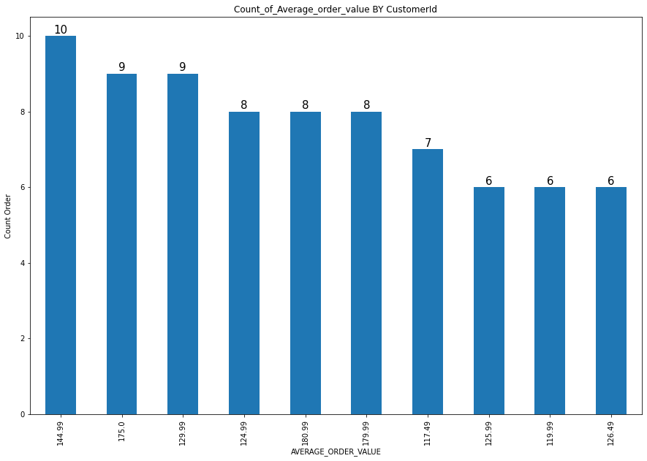
Count_of_Average_order_value By CustomerId

Slide 6
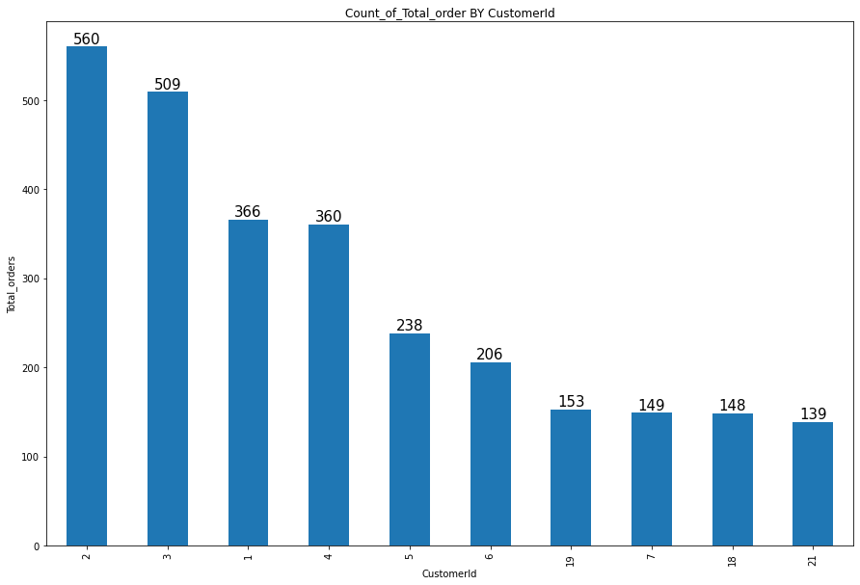
Count_of_Total_order BY CustomerId

Slide 7
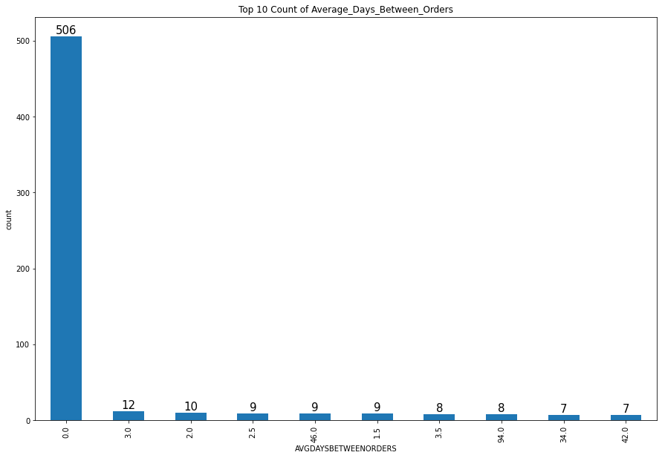
Top 10 Count of Average_Days_Between_Orders

Slide 8
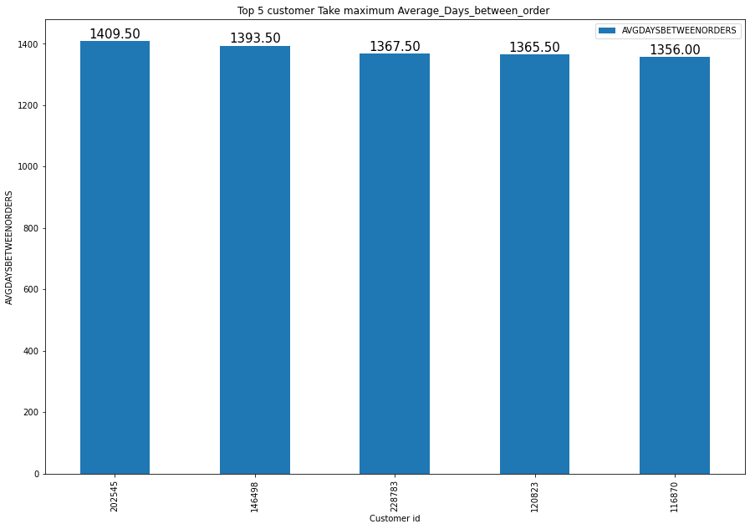
Top 5 customer Take maximum Average_Days_between_order

Slide 9
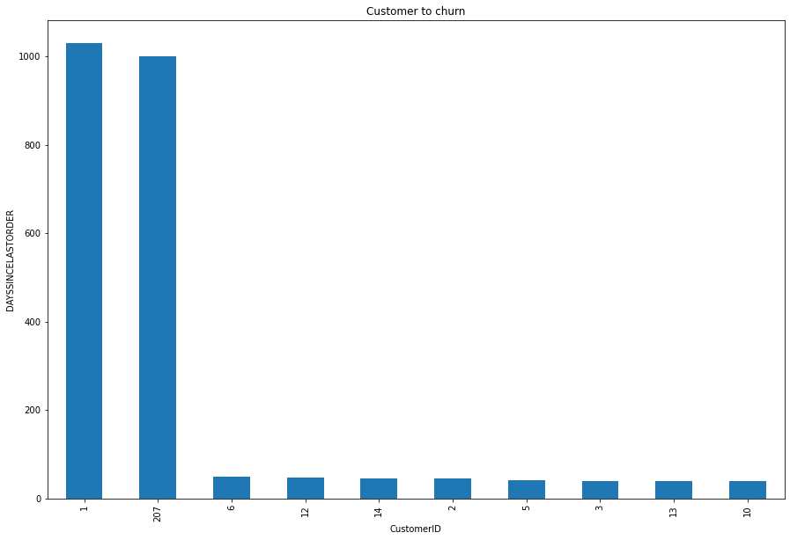
Customer going to churn out

Slide 10

SHIPPING

Slide 11
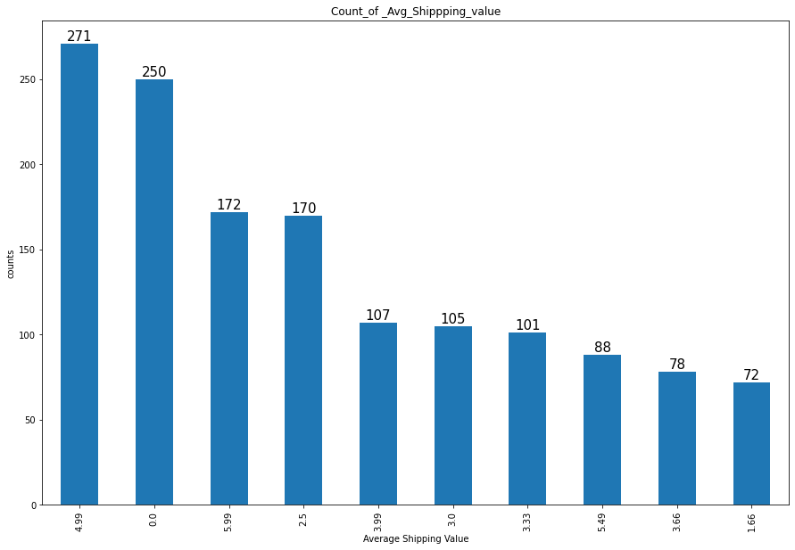
Count of Avg_Shippping_value

Slide 12

REVENUE

Slide 13
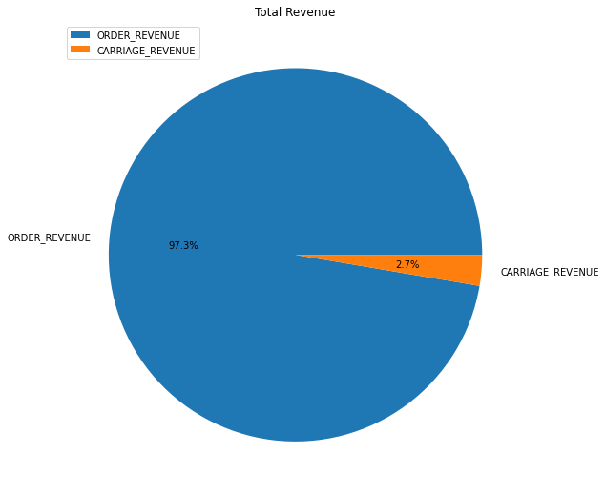
Different Source of Revenue

Slide 14
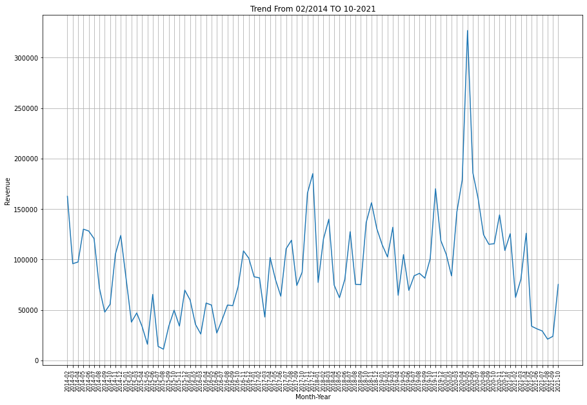
Trend From 02/2014 TO 10-2021

Slide 15
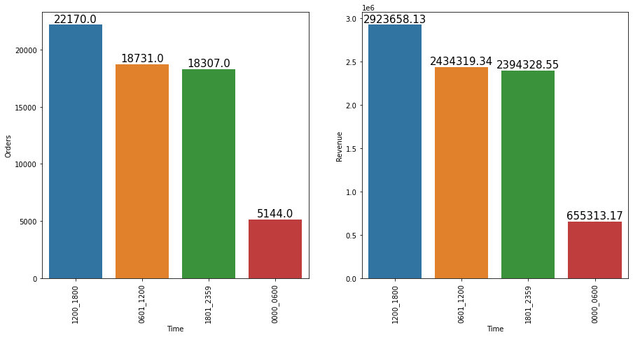
For Different time Order and Revenue

Slide 16
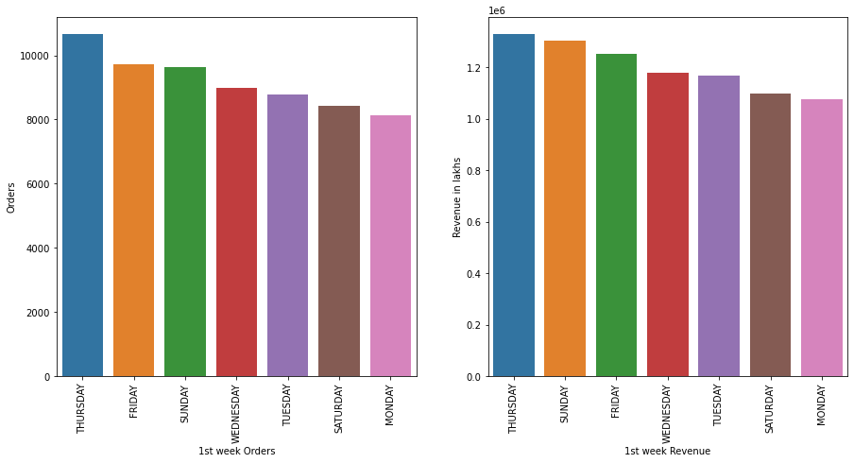
1st week Orders and 1st week Revenue

Slide 17
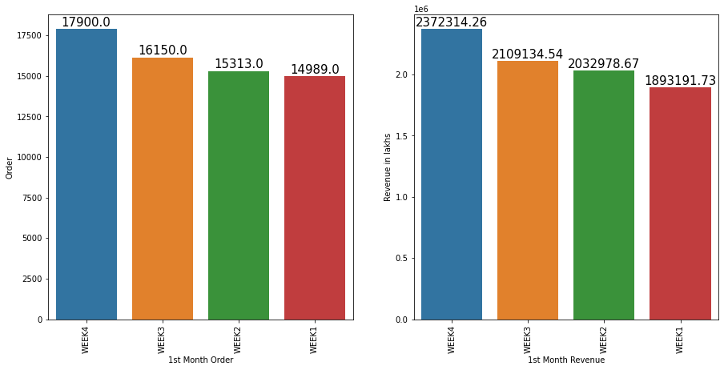
1st Month Order and 1st Month Revenue

Slide 18
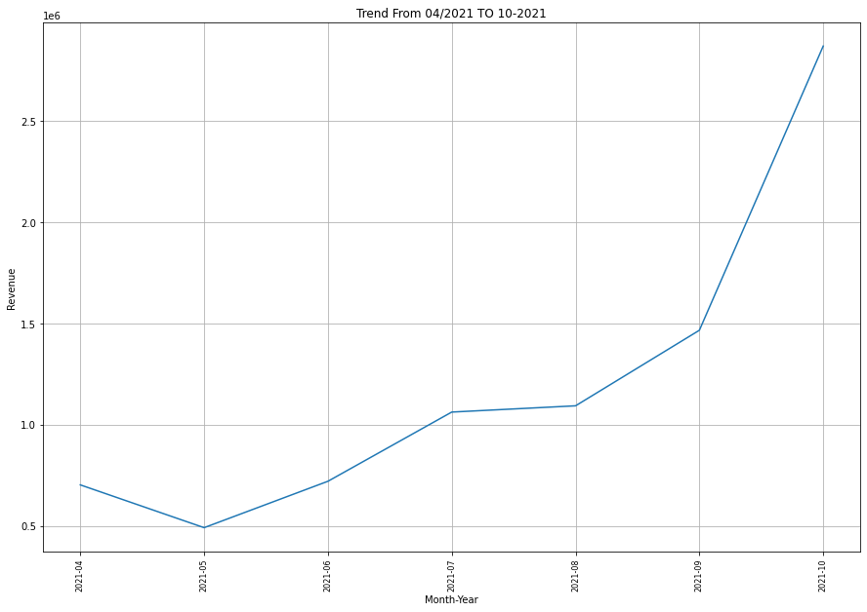
Latest Revenue Trend from 04/2021 TO 10/2021

Slide 19

Recency Frequency and Monetary value

Slide 20
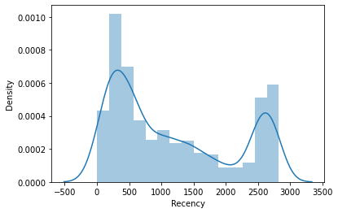
Recency

Slide 21
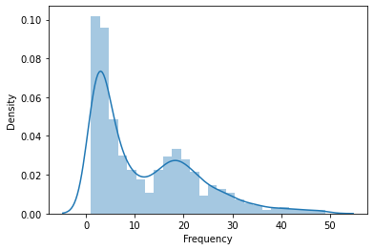
Frequency

Slide 22
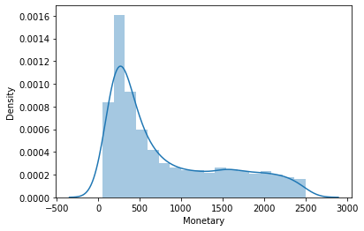
Monetary

Slide 23
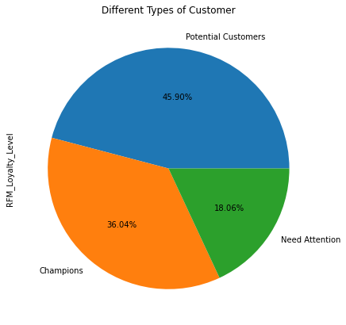
Different Type Of Customers

Slide 24
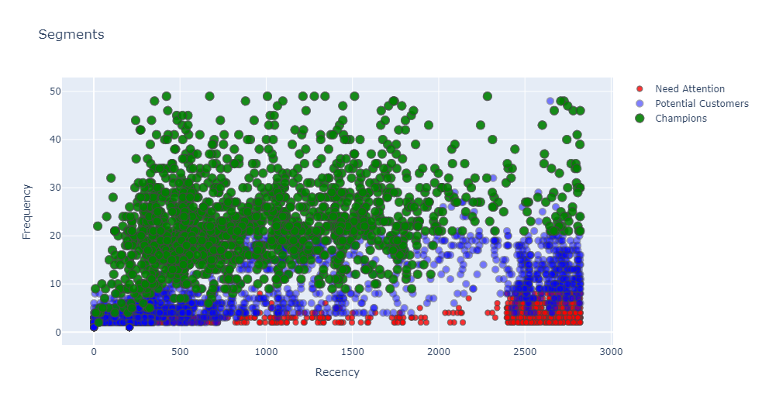
Recency Vs Frequency

Slide 25
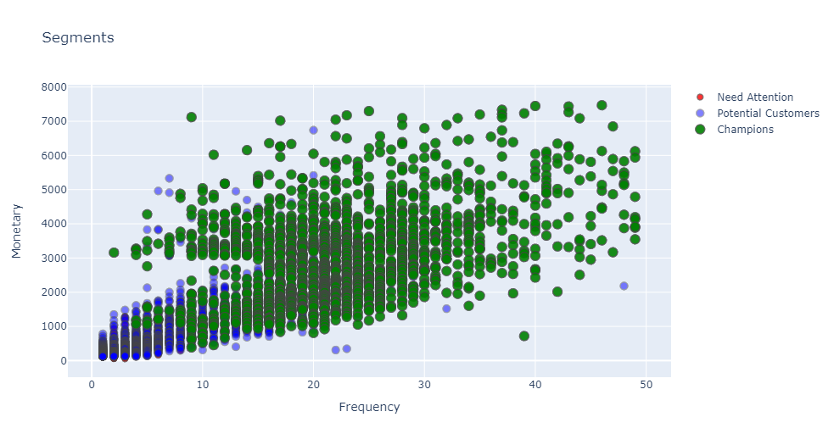
Monetary Vs Frequency

Slide 26
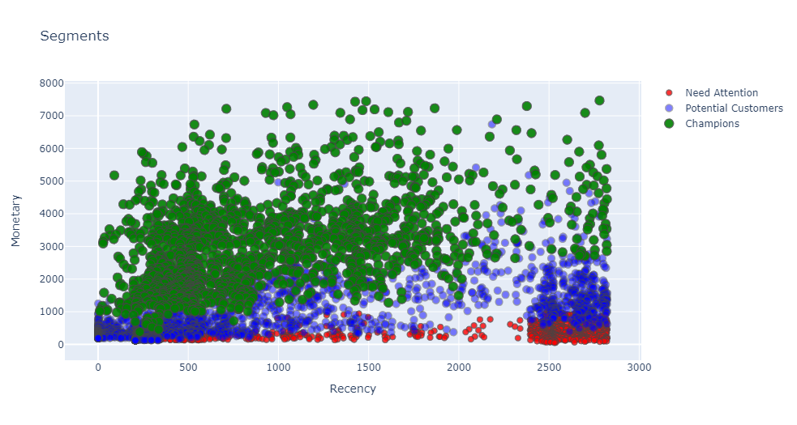
Monetary Vs Recency

Slide 27
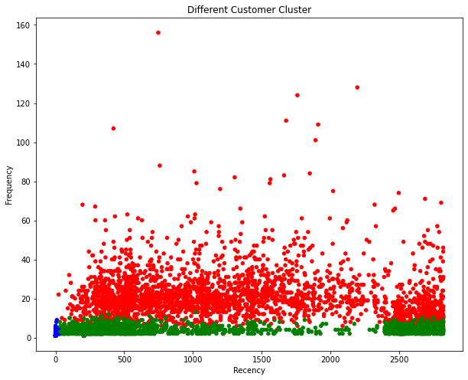
Different Cutomer Cluster
Green-Champions
Blue-Potential Customers
Red-Need Attention

Slide 28
SUMMARY
Based on this RFI modeling what should be the marketing strategy should be now ?
Customers in FM 1 group are the best customers and we can try to cross sell other products of our brand as well as we can encourage them to sign up for loyalty programs to enjoy some elite experiences like free same-day shipping priority access to newly launched products etc on the other hand if the customer is falling into our FM 2 group then company may try to offer some reward or coupon to trigger the spending from these group and if the customer is falling into our FM 3 group then company should give them discount so that they come and buy products.

Slide 29
THANK YOU

